Slide 1


1
Choose tile
2
3
Prepair JOSM
Open in
JOSM
3
4
Valid?
No
Almost
Yes
4
Quick fix?
No
Yes
5
Fix
6
6
Invalidate
Validate

Slide 2





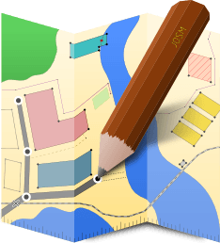

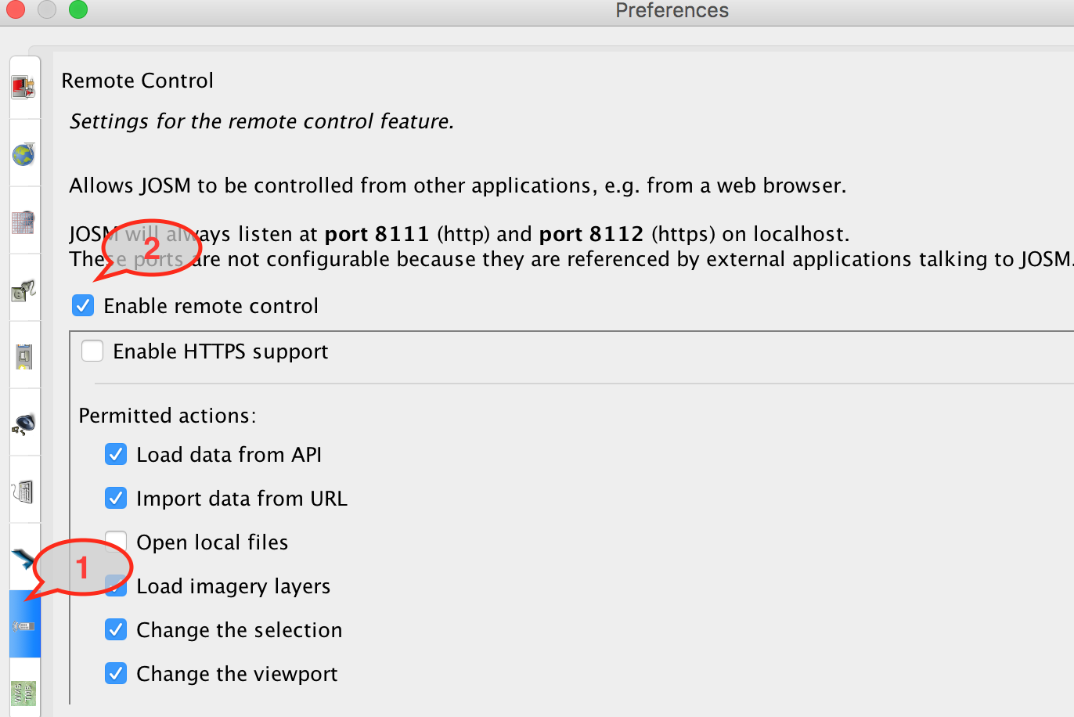
2
Check browser
Go to; https://josm.openstreetmap.de/
Choose download for windows / osx / linux
Install JOSM
Open JOSM
OSX
In the JOSM menu select Edit/Preferences (windows), or JOSM/Preferences (OSX)
Click on the remote control icon (1)
Select "Enable Remote Control" and click OK. (2)
Restart JOSM

Slide 3

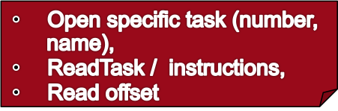
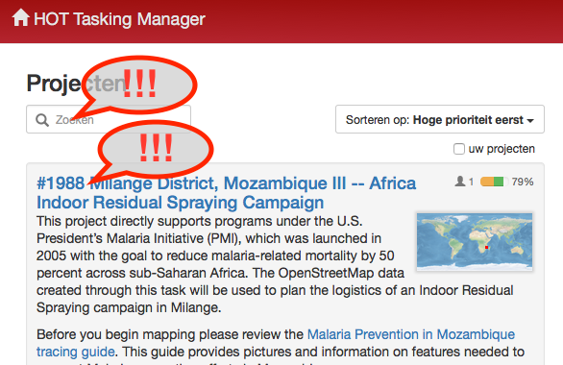
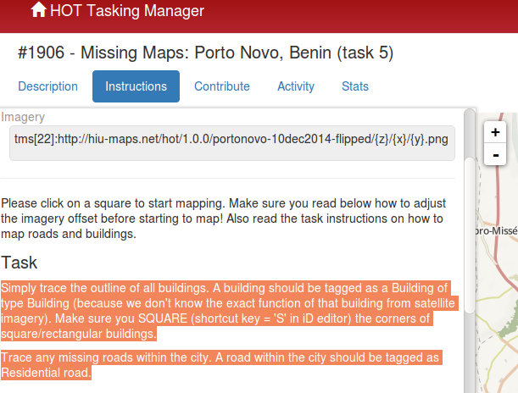


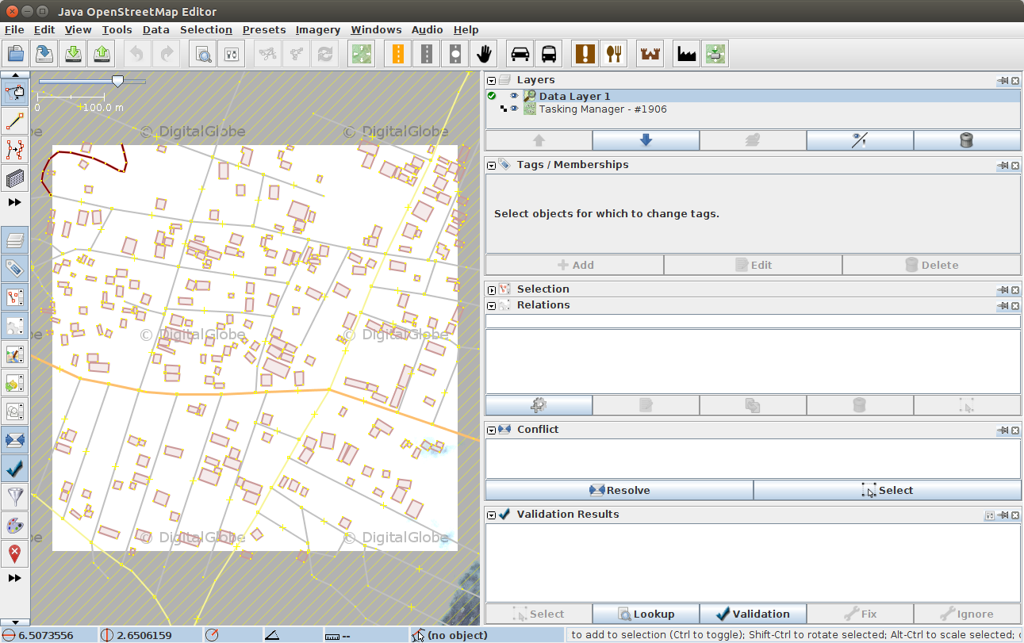

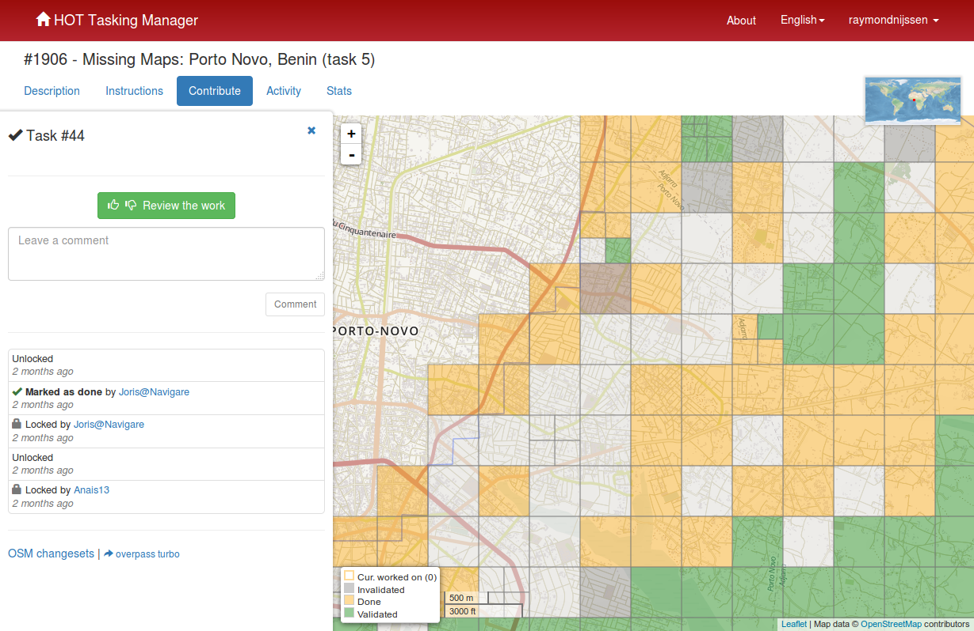



3
Open
tasks.hotsosm.org
Choose
yellow tile
Start
validating JOSM
>3A
Check offset

Slide 4

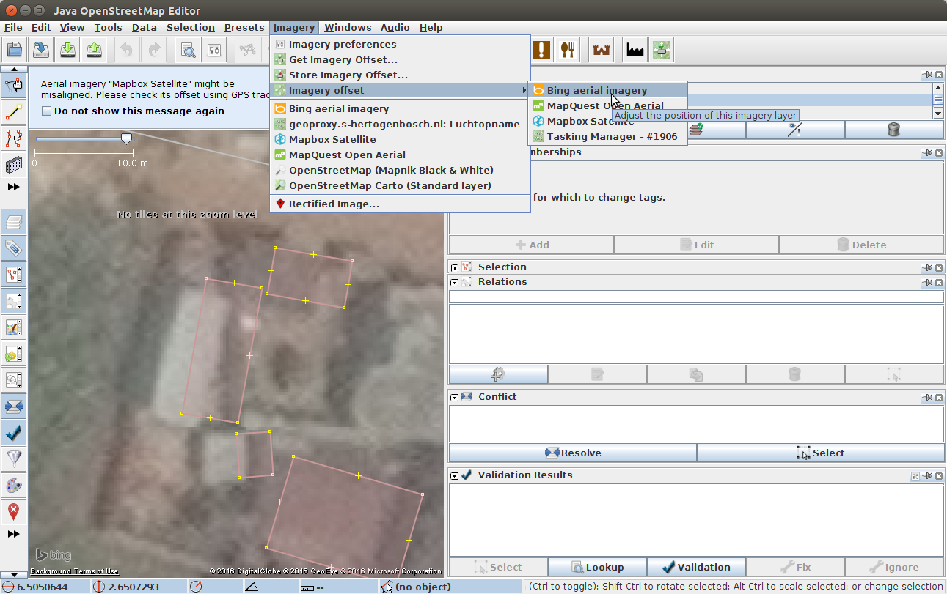
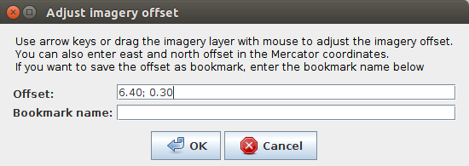

3A
Check offset

Slide 5

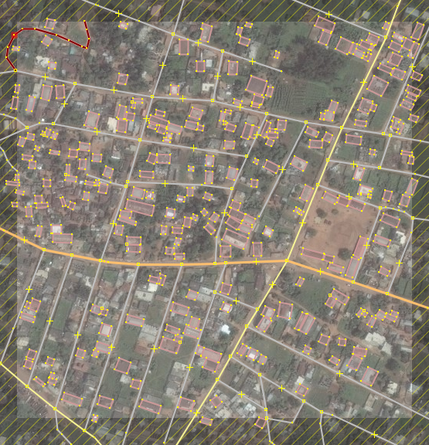

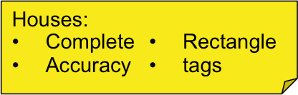
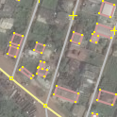
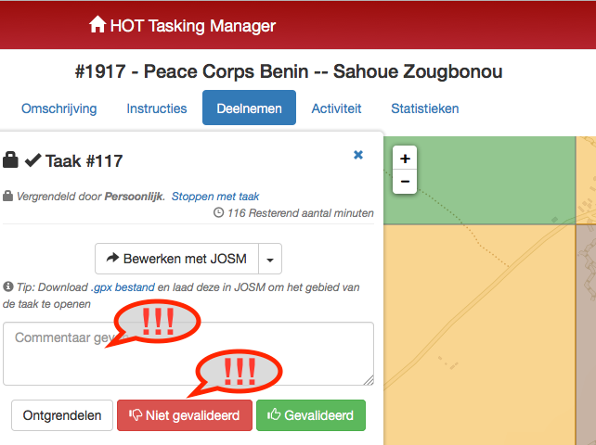
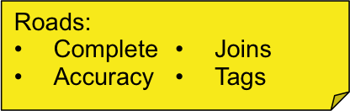
4
Review tile
First quick impression:
>10 min fixing time: stop validating
Yes/almost: start check and fix missing and wrong objects.
Valid?
No
Almost / Yes
Stop validating
Check tile

Slide 6

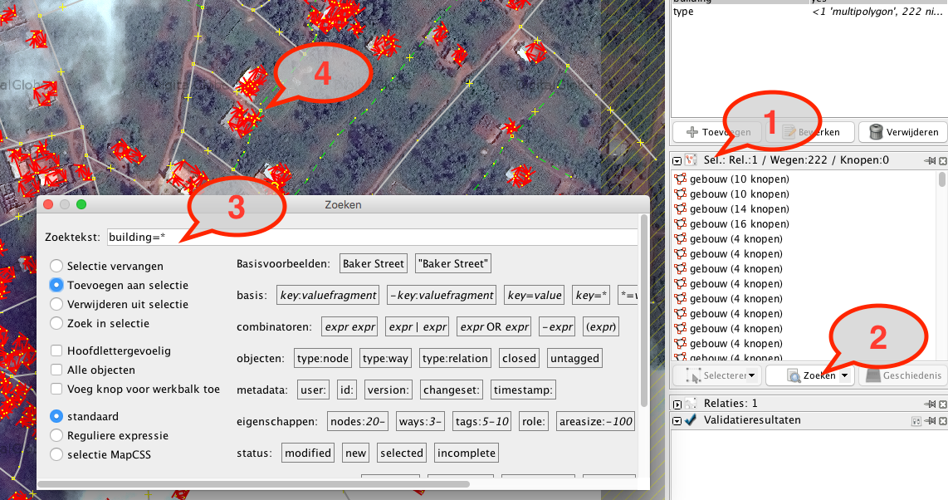
3B
4B
1. Select buildings
check tags (all? right one?)
..,,
2. Select roads,
check tags (all? right one?)
…
4
1
2
Select tool
Go to window/search
For all buildings: building=*
For all roads: highway=*
_x0016_
3

Slide 7

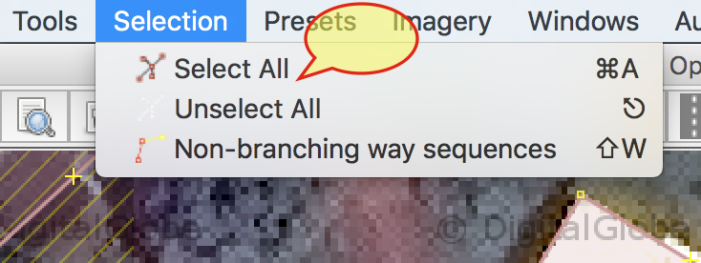
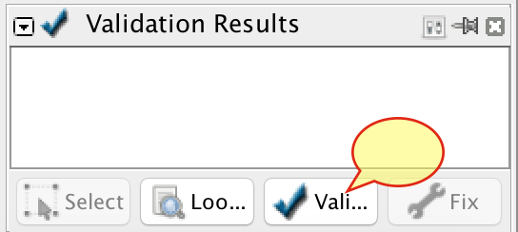
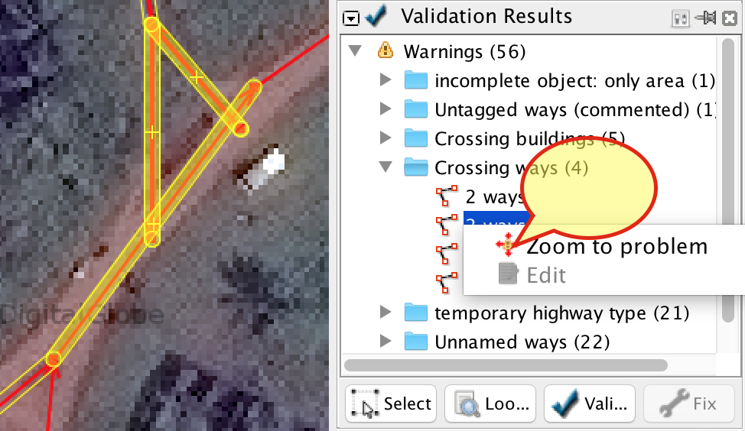
Validate tool
Select all
Validate > Validation
Warnings
Check and solve all warnings, except unnamed ways.

Slide 8

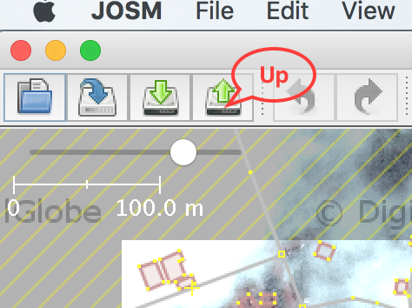
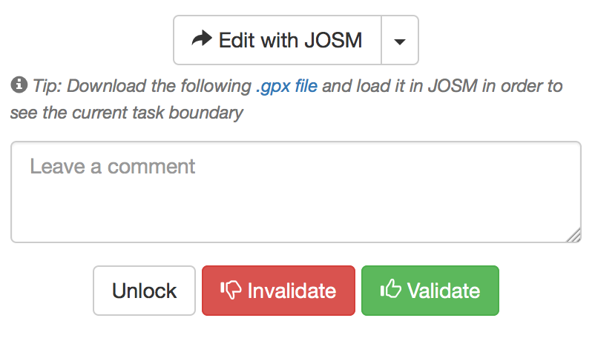

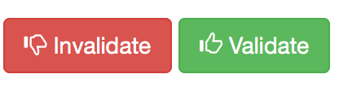
6
Upload data
Invalidate:
Incomplete
wrong tags
conflicts
Validate:
content of map (buildings, highways, ..)
completeness
clouds %
Comment
(in)Validate

